Slide 1
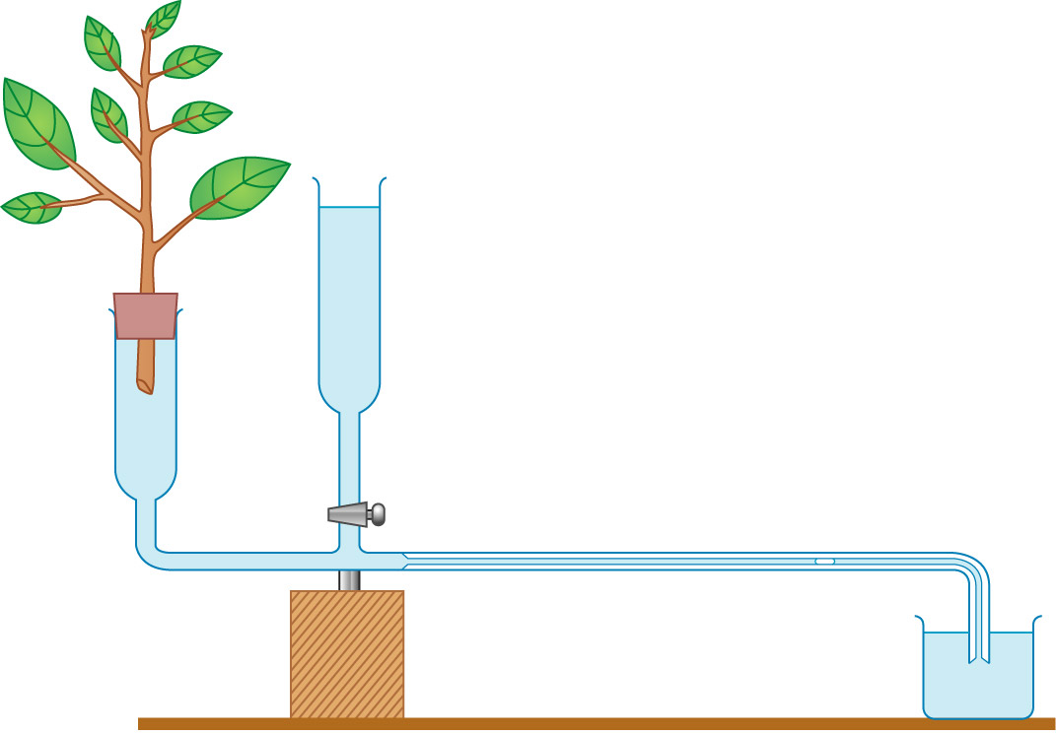
Bubble potometer
Objective
Measure the transpiration rate of a leafy shoot using a bubble potometer
video

Slide 2

Bubble potometer
Principle
- most of the water taken up is lost by transpiration
evaporation of water and diffusion of water vapour out through stomata
>>transpiration pull >> water uptake
- environmental conditions

Slide 3
Assumption
Rate of water uptake = rate of transpiration

Slide 4
Precautions
Prevent air from entering the xylem vessels thus block upward movement of water
- cut the leafy shoot and fit into potometer
under water
  - not allowing the bubble to enter the leafy shoot
Airtight – seal all junctions with vaseline
Size of bubble should be small
- prevent movement of it being slowed down /
breakage of continuous water column

Slide 5

Oil in the reservior??
No
Function of reservoir – refill the capillary tube and push the bubble backwards
Evaporation does not affect the measurement of bubble movement

Slide 6

Results
Distance moved by the bubble = _____cm
Time taken = ______min
Rate of movement of air bubble = _____
Rate of transpiration = ___________

Slide 7
Discussion
“Absorption = transpiration” not accurate
  Shoot is very much dehydrated
  Under dry and windy conditions
Bubble potometer does not function well
  Not air tight
  Air is trapped

Slide 8
Limitations of bubble potometer to measure rate of transpiration
It actually measure the rate of water uptake but not rate of transpiration.
The root system has been removed, so the amount of water absorbed may be lower than normal.

Slide 9
Possible errors
There is friction between the bubble and the capillary wall. This may slow the movement of bubble.

Slide 10
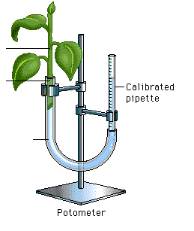
Simple potometer
leafy shoot
glass tubing
rubber tubing
stand and clamps
(upside down)
At ___________, the reading from the pipette is ________ mL.
At ___________, the reading from the pipette is _________mL
The rate of transpiration =______________________

Slide 11
Simple potometer
leafy shoot
glass tubing
rubber tubing
stand and clamps
(upside down)
Limitation
- too small to be used for a whole plant.
extensive root system is too big to be put inside the
potometer, without the roots, the rate of water uptake is
smaller than normal.
It actually measures the rate of water uptake rather than the
rate of water loss.

Slide 12
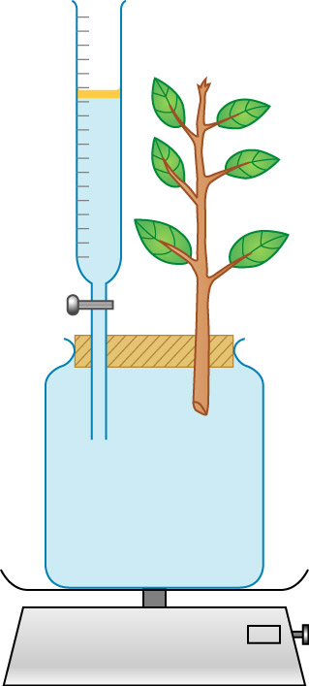
Weight potometer
Objective
Measure the transpiration rate of a leafy shoot using a weight potometer
video

Slide 13
Amount of water lost
= Wi – Wf
Rate of water lost (transpiration)
= (Wi –Wf)/time
Amount of water absorbed
= Vi – Vf
Rate of water uptake
= (Vi – Vf) /time
*Compare rate of water lost and rate of water uptake, which one should be larger when the plant is in a healthy condition?

Slide 14
Is it necessary to add a layer of oil on the water surface in the burette?
To reduce water evaporation from the burette which may cause the overestimation on the amount of water uptake and water loss through transpiration.

